Slide 1
moose for dcs world SCORING

Slide 2
scoring

Slide 3
why a scoring class in moose?
Independent scoring logic from DCS.
Positive scores and negative penalties make a total score.
Objects scored are Units, Statics and Scenery.
Log the scoring in CSV files for statistics on web sites.
Automatic calculation of scores based on:
the threat level of the object destroyed.
the threat level of the player destroying the object.
Score achievements:
Grant additional scores when players destroy specific objects.
Specify destruction zones where additional scores are granted when objects are destroyed.
Display messages when scores are achieved by players. Messages can be customized:
Define the target audience of the messages, which can be all players or the coalition.
Switch messages on/off for specific events (hit, destroy, specific, zone).
Grant scores or penalties at specific events to players.
Scale the scores for specific missions.
Set a level of fratricide. Players cannot just go on shooting friendlies.
Reporting system during a running mission that players can consult. Various reporting levels.

Slide 4
score is calculated based on threat level
TARGET
Threat | 0 | 1 | 2 | 3 | 4 | 5 | 6 | 7 | 8 | 9 | 10
0 | 0 | 1 | 2 | 3 | 4 | 5 | 6 | 7 | 8 | 9 | 10
1 | 0 | 1 | 2 | 3 | 4 | 5 | 6 | 7 | 8 | 9 | 10
2 | 0 | 1 | 2 | 3 | 4 | 5 | 5 | 6 | 7 | 8 | 9
3 | 0 | 1 | 2 | 3 | 4 | 4 | 5 | 6 | 7 | 7 | 8
4 | 0 | 1 | 2 | 3 | 3 | 4 | 5 | 5 | 6 | 7 | 8
5 | 0 | 1 | 2 | 2 | 3 | 4 | 4 | 5 | 6 | 6 | 7
6 | 0 | 1 | 2 | 2 | 3 | 4 | 4 | 5 | 5 | 6 | 7
7 | 0 | 1 | 2 | 2 | 3 | 3 | 4 | 5 | 5 | 6 | 6
8 | 0 | 1 | 2 | 2 | 3 | 3 | 4 | 4 | 5 | 5 | 6
9 | 0 | 1 | 2 | 2 | 3 | 3 | 4 | 4 | 5 | 5 | 6
10 | 0 | 1 | 1 | 2 | 2 | 3 | 3 | 4 | 4 | 5 | 5
PLAYER

Slide 5


scores are granted upon hits and shared upon destroy
Each player that hits an object is awarded with one point.
If the same player hits multiple times the same objects within one second, then only 1 point will be awarded.
If an object is destroyed by a player, then the number of poins awarded will be calculated based on the threat levels of the player and the object destroyed.
Destroy Score
Hit Score
Hit
Destroy
If multiple players hit the same object,
then each player will receive a point. Those players are considered to be cooperating on the same target.
If one of those players destroy that target,
then those players that were considered to be cooperating on the same target will receive a score.
Destroy Score
Hit Score
Hit
Hit
Destroy
Destroy Score
Hit Score

Slide 6
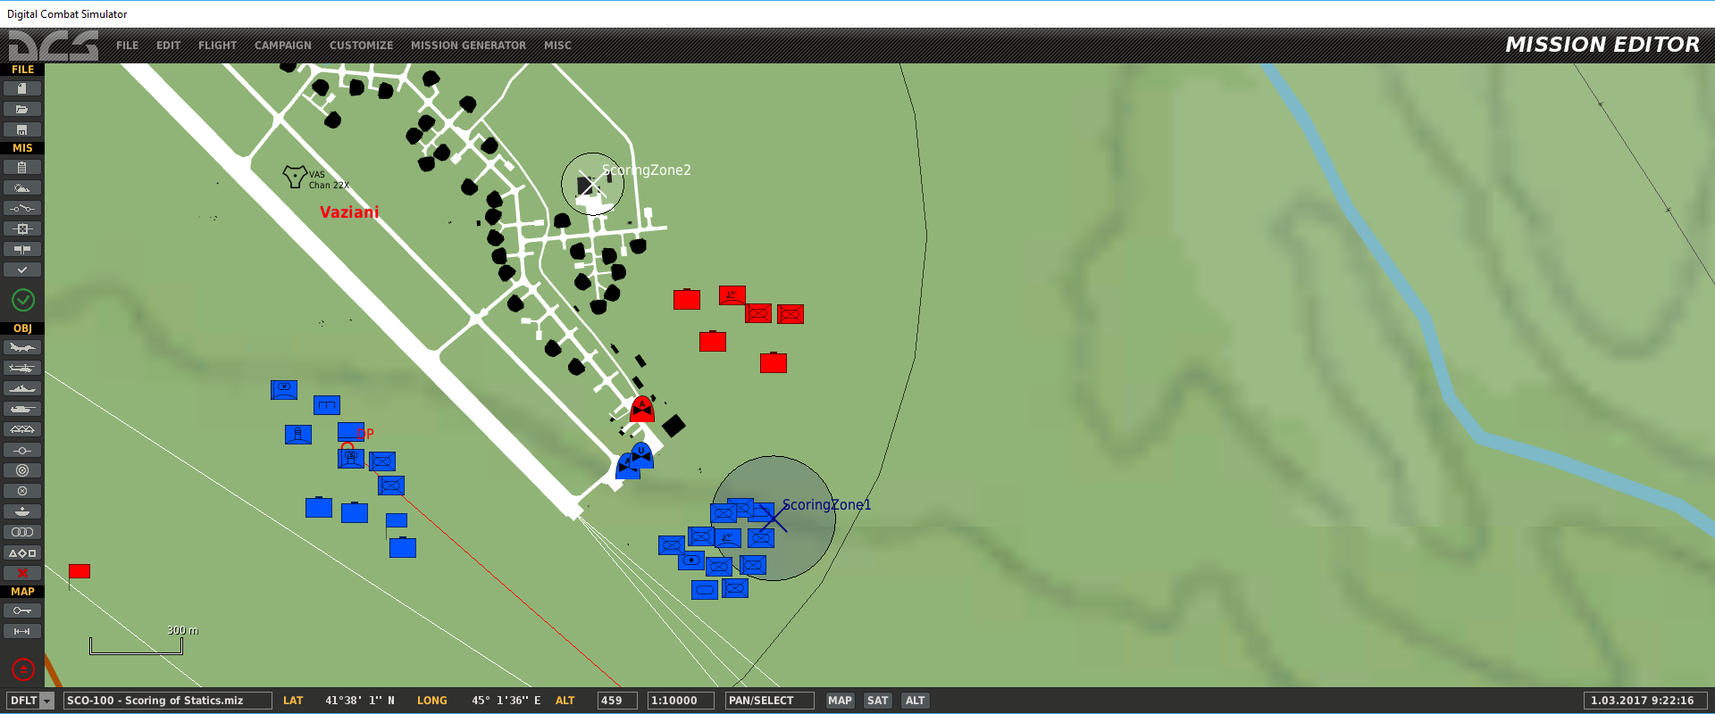
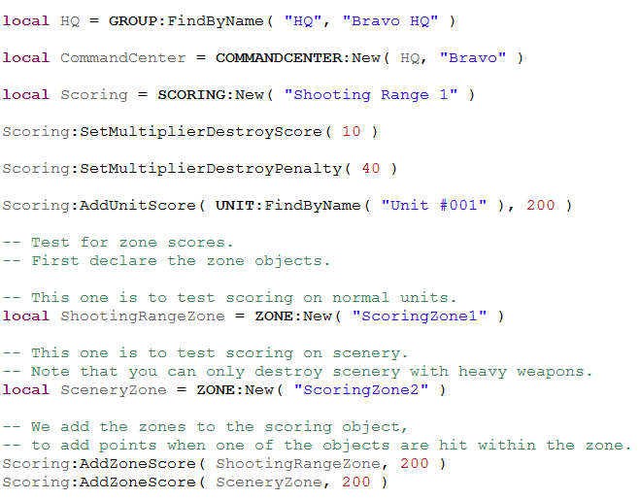
define a scoring anywhere in your mission

Slide 7
scores are granted upon hits and shared upon destroy
Destroy Score
Hit Score
Hit
Destroy
Hit
Destroy
+ Addon Score!
Assigned Target
Assigned Target
When a target is assigned by the scoring system, upon a hit by a player, one point will be rewarded.
When a target is assigned by the scoring system, when that target is destroyed, additional scores will be rewarded to that player!

Slide 8
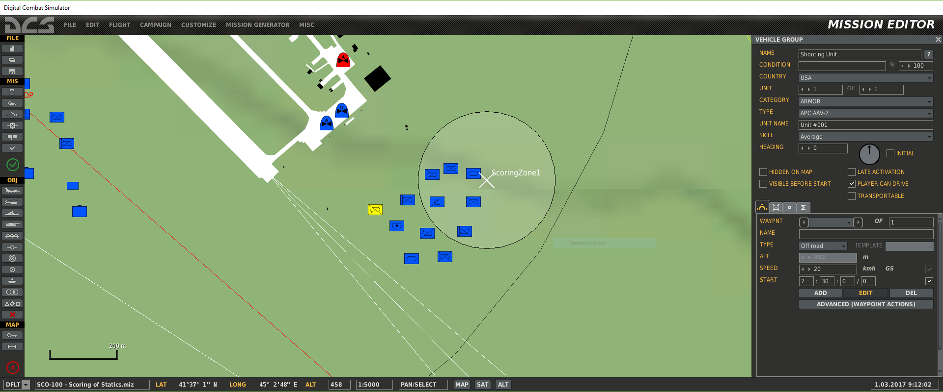
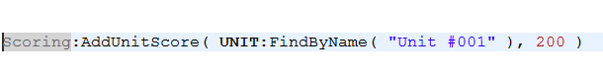
specific targets for additional score

Slide 9
zones can be defined to set assigned targets
When a target is located in a scoring zone, upon a hit by a player, one point will be rewarded.
When a target is located in a scoring zone, when that target gets destroyed by a player, extra points will be rewarded to that player!
Destroy Score
Hit Score
Hit
Destroy
Hit
Destroy
Assigned Target
in Zone
Assigned Target
in Zone
+ Addon Score!

Slide 10
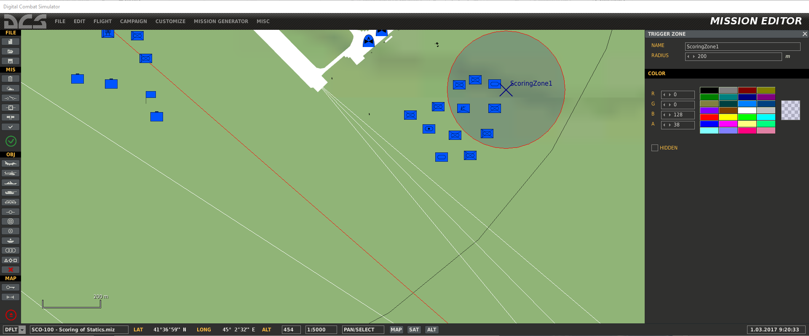
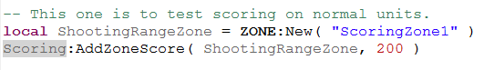
define zones for unit or static additional scores

Slide 11
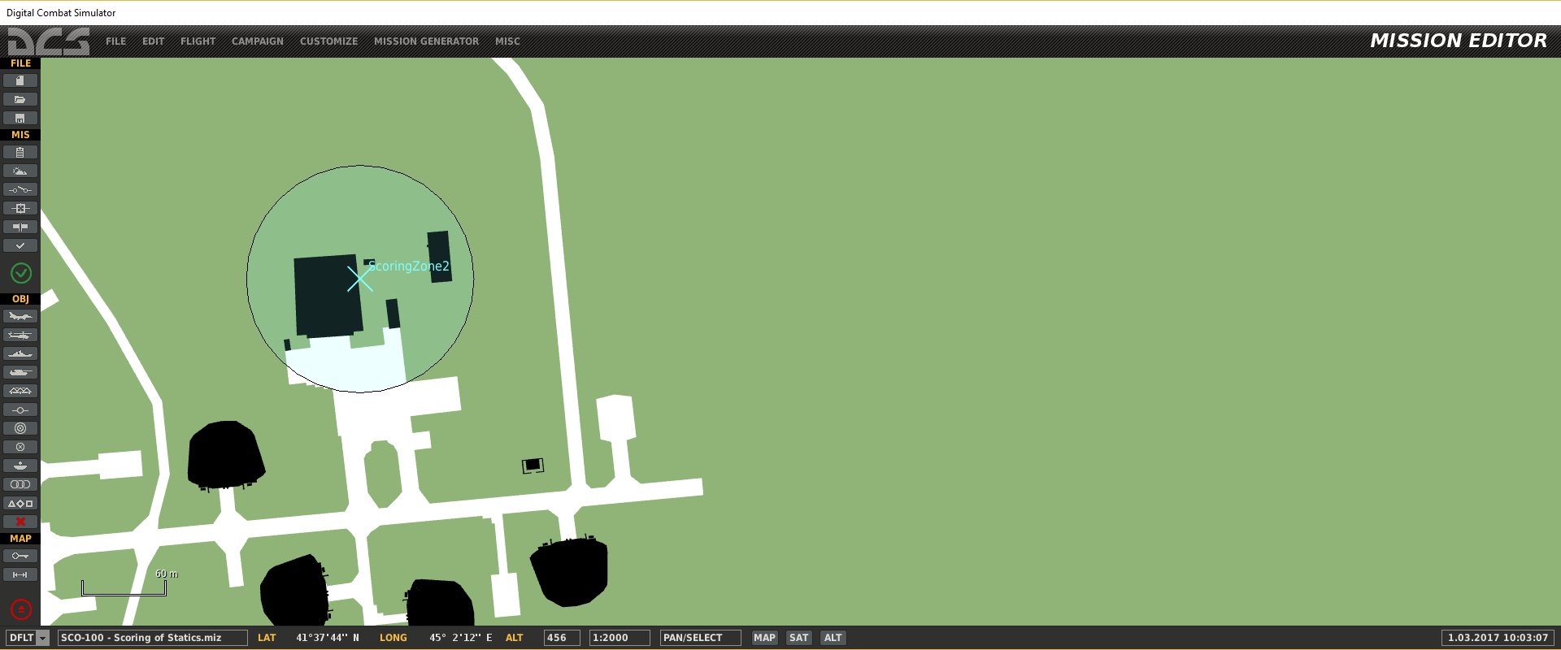
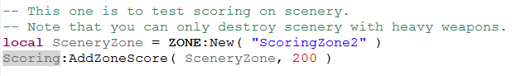
define zones for scenery targets for additional scores

Slide 12
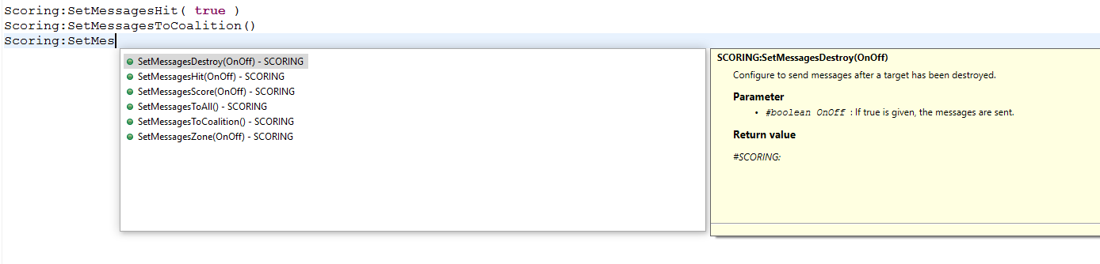
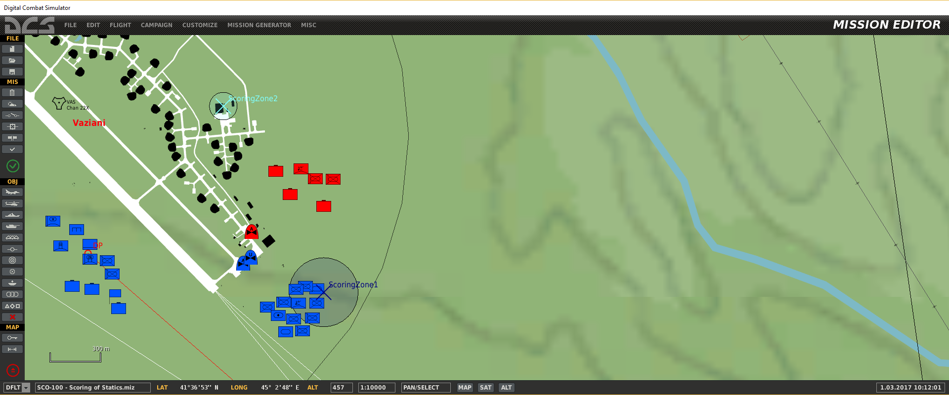
customize messages

Slide 13
score can be scaled. For example this is a scale for a scoring of 30
TARGET
Threat | 0 | 1 | 2 | 3 | 4 | 5 | 6 | 7 | 8 | 9 | 10
0 | 0 | 3 | 6 | 9 | 12 | 15 | 18 | 21 | 24 | 27 | 30
1 | 0 | 3 | 6 | 9 | 11 | 14 | 17 | 20 | 22 | 25 | 28
2 | 0 | 3 | 5 | 8 | 10 | 13 | 15 | 18 | 20 | 23 | 25
3 | 0 | 3 | 5 | 7 | 10 | 12 | 14 | 17 | 19 | 21 | 24
4 | 0 | 3 | 5 | 7 | 9 | 11 | 13 | 15 | 18 | 20 | 22
5 | 0 | 2 | 4 | 6 | 8 | 10 | 12 | 14 | 16 | 18 | 20
6 | 0 | 2 | 4 | 6 | 8 | 10 | 12 | 14 | 15 | 17 | 19
7 | 0 | 2 | 4 | 6 | 8 | 9 | 11 | 13 | 15 | 16 | 18
8 | 0 | 2 | 4 | 5 | 7 | 9 | 10 | 12 | 14 | 15 | 17
9 | 0 | 2 | 4 | 5 | 7 | 8 | 10 | 12 | 13 | 15 | 16
10 | 0 | 2 | 3 | 5 | 6 | 8 | 9 | 11 | 12 | 14 | 15
PLAYER

Slide 14
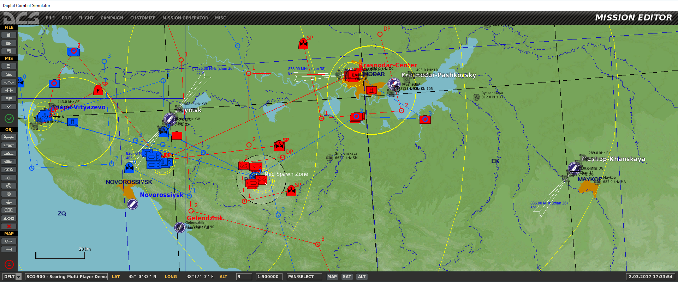

scale scores and penalties
The default scale of valid target Scores is 10, Penalties have a default scale of 30.
These scales can be tweaked with :SetScaleDestroyScore() and :SetScaleDestroyPenalty().

